Slide 1
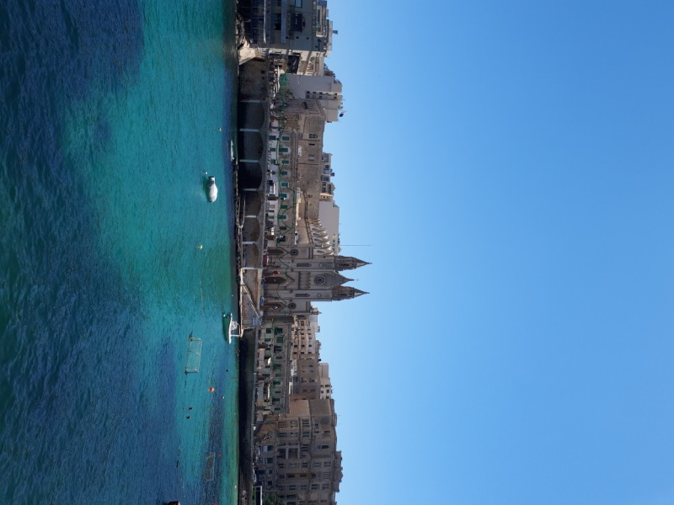
Mobilność kadry edukacji szkolnej
Program Operacyjny Wiedza Edukacja Rozwój
International High Five for Teachers:
Together for innovation
Malta 16 – 28 July 2017
Emilia Buczak

Slide 2
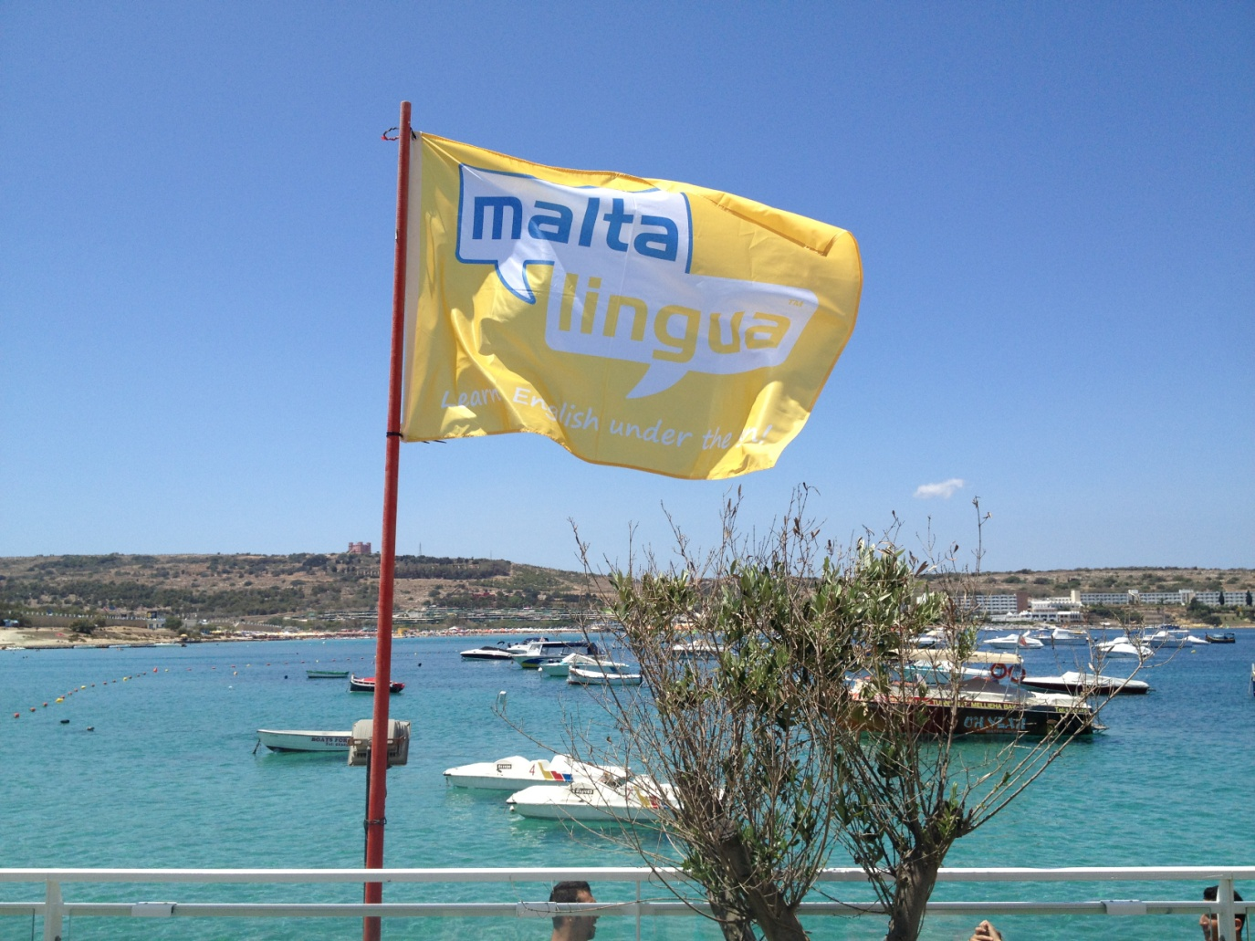
In July 2017 I had a possibility to take part in a very interesting language project - 2 weeks of english language course on Malta.

Slide 3
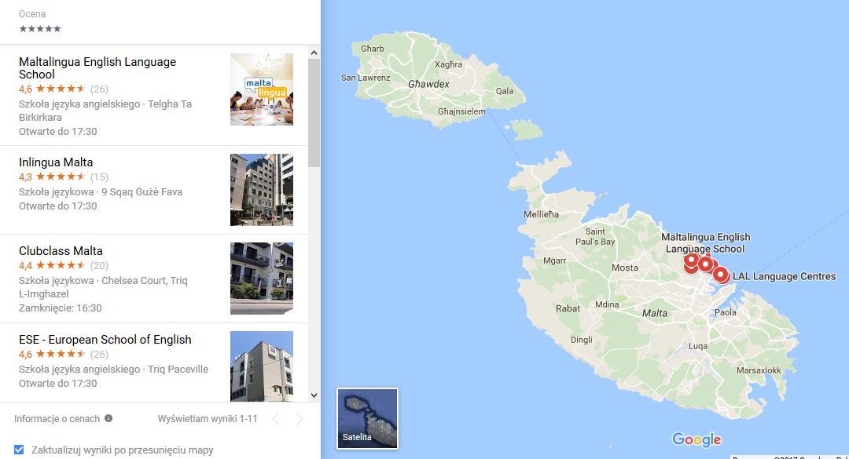
First step - find good language school on Malta
Before the trip I spent many hours on the Internet – I read a lot of opinions about Malta’s language schools, about the teachers, prices, location and accomodation. After that I chose Maltalingua School of English in St. Julians.

Slide 4

I contacted with the school manager and asked about the
terms of courses, payment, teachers and other important
things. Then I booked the flight and accomodation.

Slide 5
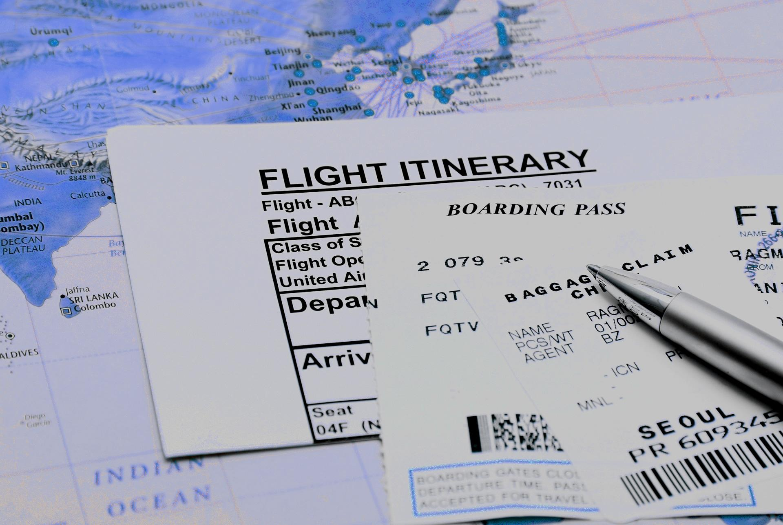
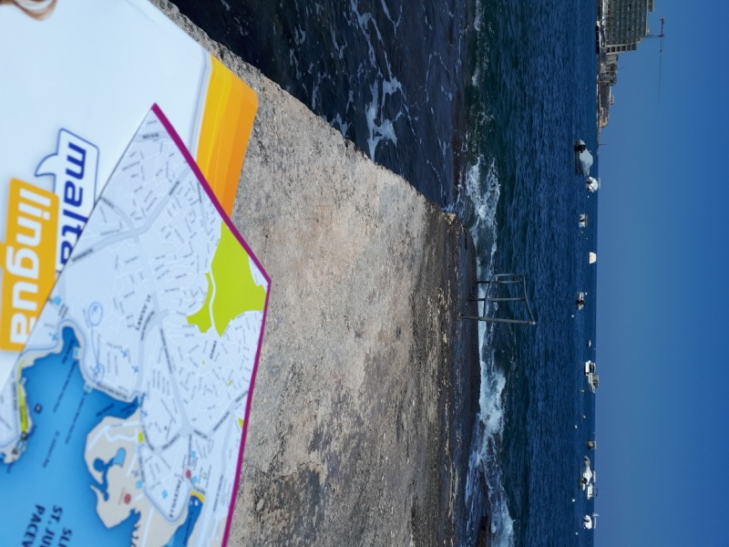
Preparing trip to Malta was my first valuable work experience in English – I had to prepare everything independently, without a tutor, travel agent or English teacher.

Slide 6
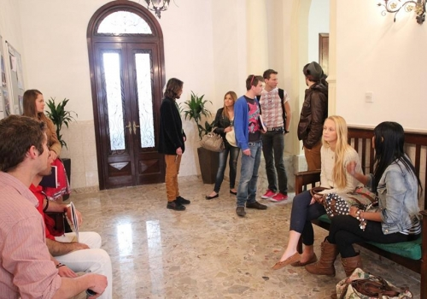
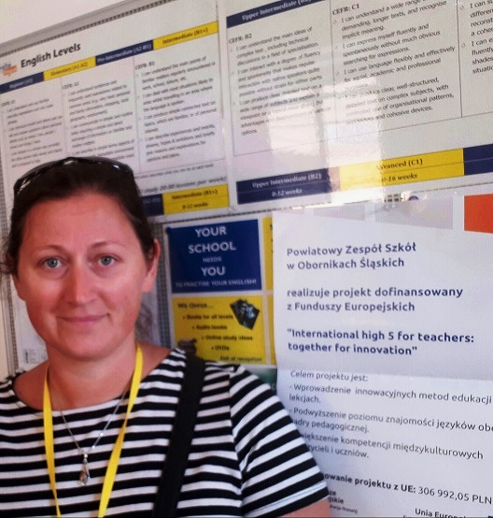
My school - Maltalingua
It’s a small language school in the heart of St. Julians, just a few steps from the seaside.

Slide 7
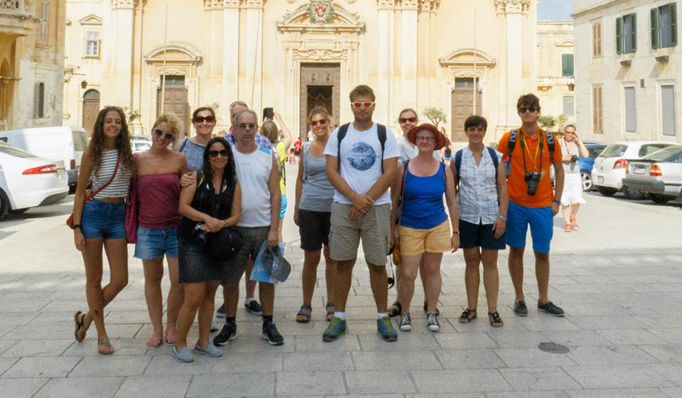
Lessons
My group had English lessons with two teachers – Karen from England and Rachel from Scottland. Karen was speaking English with perfect British accent but Rachel had strong Scottish accent, so it was sometimes really difficult to understand her.

Slide 8
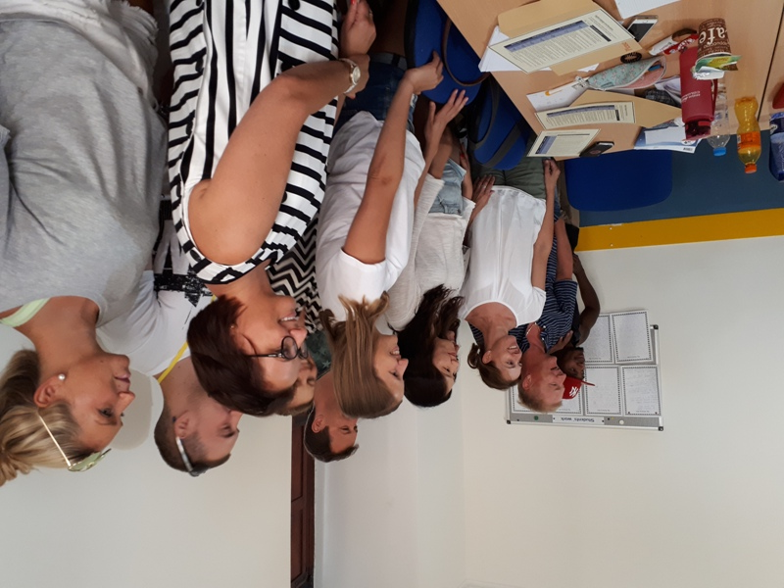

During the lessons I had opportunity to use new working methods – we played English scrabble, we explained new words or sentences by the pantomime and we took part in few intensive discussions about politics, enviroment, school system in our countries and about the future of our world.

Slide 9
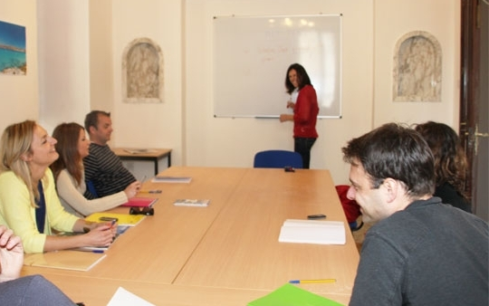
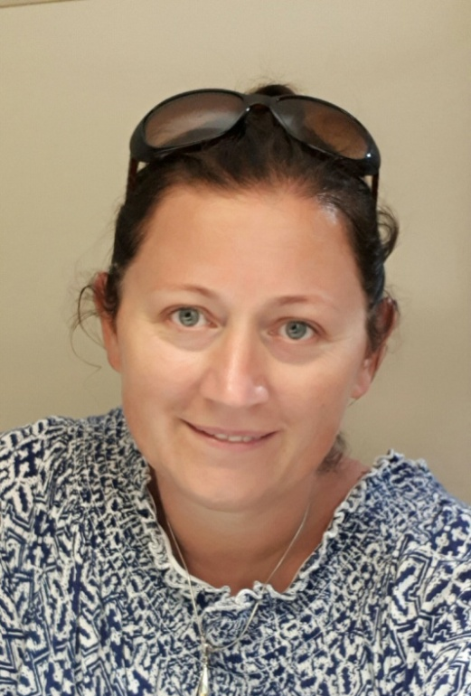
My group
Students in my group came form Poland, Russia, Finland, South Korea, Madagascar, Spain, Italy and Estonia. A really international and multicultural society ☺
And that was interesting and funny experience – we had possibility to hear so many different accents when we pronounced the same word with our native accent…

Slide 10

















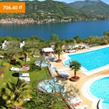
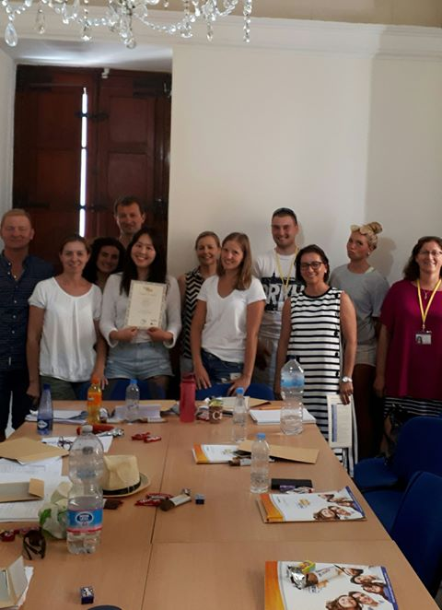


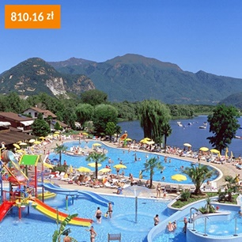
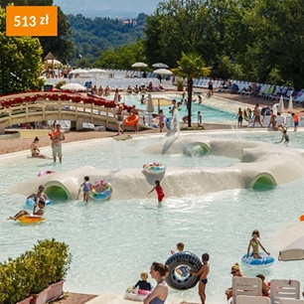
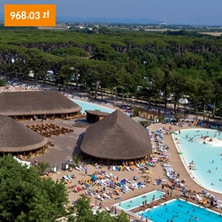
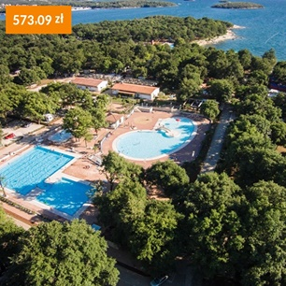

Through meetings and discussions with people from so many different countries I know, that our diversity is a power and great treasure of Europe.

Slide 11
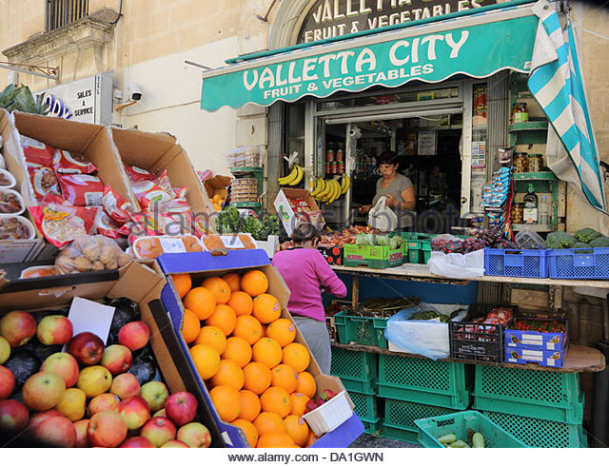
The next good news is…
Everyone on Malta can speak English – sometimes very fluently,
sometimes basicly, but you can speak English all day – at
school, at public transport, in the restaurant, in museum or
in the travel office. So it means you can polish your English
all the time, in various situation.

Slide 12
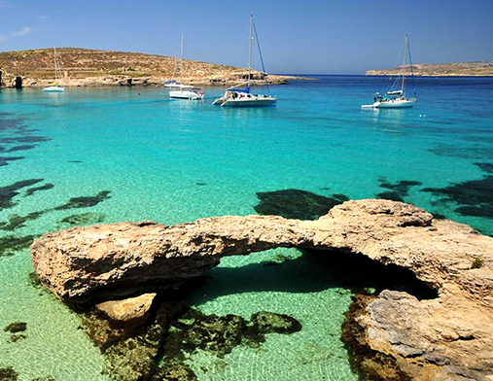
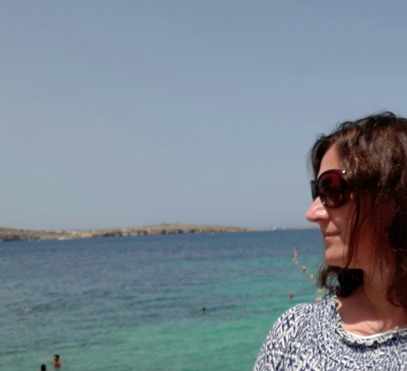
After-school activities
Malta is a small island but ite has a lot to offer – fantastic
beaches, sun all day, friendly inhabitans and great historical
monuments. It is not possible to get bored there.

Slide 13
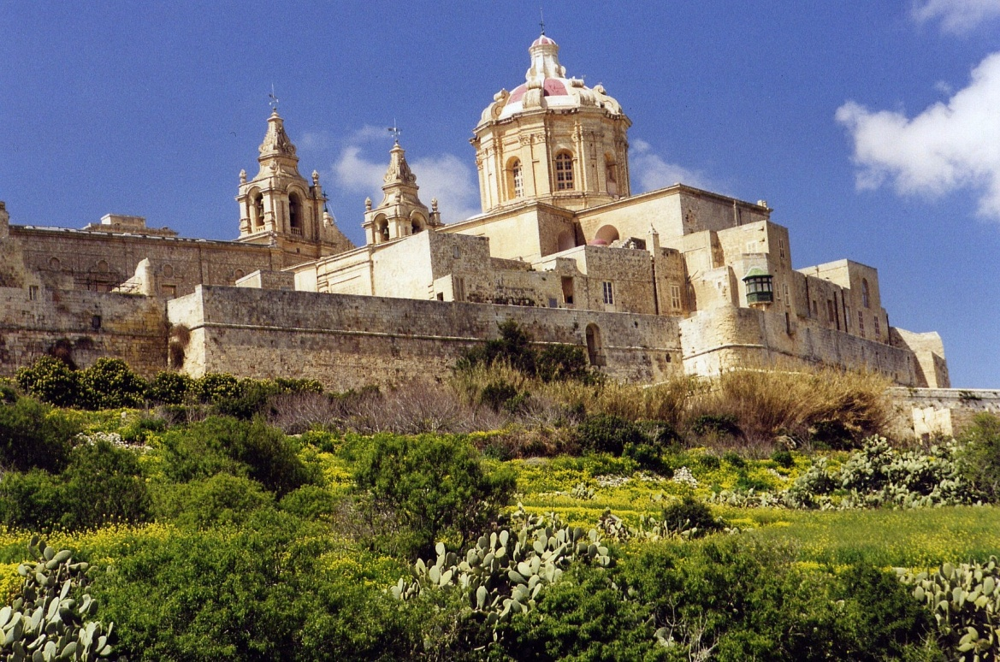
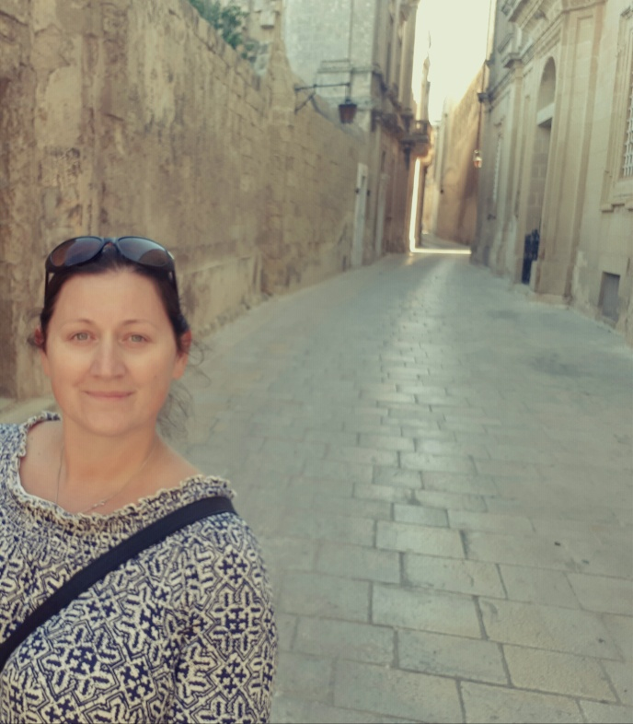
Sightseeing
If you like architecture and you are interested in history,
you can spend many hours in the narrow streets in old
capital city Mdina, which was built in medieval time. Mdina
is like an old citadel with big gates and walls. And this is a place
where famous TV series „Game of thrones” was filmed.

Slide 14
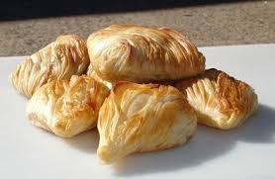
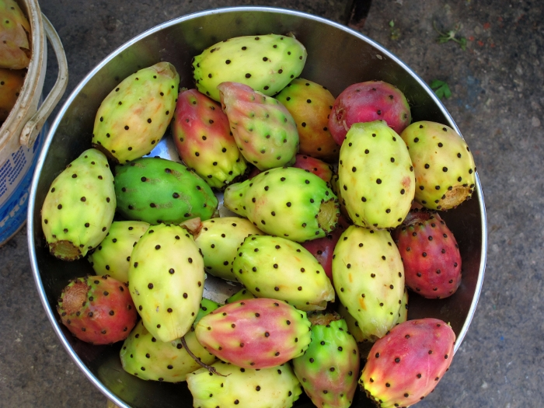
Maltese cuisine…
National Maltese dish is rabbit. When you are very hungry, you must taste pastizzi – small snack with wegetables or chicken. On market you can buy „prickly
pears” – red and sweet cactus fruit (without spikes! ☺) .

Slide 15
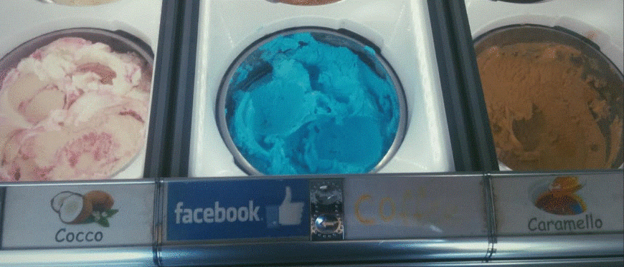
… and modern cuisine
Facebook ice cream ;-)

Slide 16

So, If you are curious about the world, if you like people, and if you like discovering new or different things, a language course in another country will be a very valuable experience for you.
You will return richer! ☺

